Slide 1
New Smyrna Beach Police Department
One Team, One Mission

Slide 3
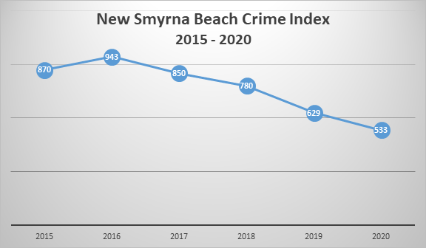

Slide 4
NSBPD staffing
Total authorized PD staffing – 75 FTE (6 vacancies – 4 sworn/2 support)
Sworn – 53 (49 actual)
Leadership – 4
Sergeants – 6
Corporal – 4
Officers – 39 (35 actual)
Support –
Full time – 16 (15 actual)
Part-time – 12 (10 actual)

Slide 6
2021-2022 Budget requests
Vehicles: 7 patrol vehicles $400,603
Mobile radio P25 compliance: $60,000 FY21 - $60,000 FY22
A/C refurbish/repair: $95,000
License Plater reader (LPR) partnership with Venetian Bay HOA: $88,912

