Slide 1
Leisure Services
Consists of
  Administration / Recreation and Special Events
    Alonzo “Babe” James Community Center
    City Gym
  Brannon Civic Center
    Live Oak Cultural Center
    Coronado Civic Center
    New Smyrna Beach Woman’s Club
  Sports Complex

Slide 2
Leisure Services - Vision
Leisure Services provides places and recreation opportunities for all people to gather, celebrate, contemplate, and engage in activities that promote health, well-being, community and the environment.

Slide 3
Leisure Services - Staffing
Staffing - FTE | 2021 | 2022 | Prior Year Change
Administration / Recreation | 10.5 | 10.5 | 0
Brannon Civic Center | 4 | 4 | 0
Sports Complex | 5 | 6 (2 pt emp) | +1
Total | 19.5 | 20.5 | +1
*Note: There are 6 P.T.E. for the Summer Fun Program

Slide 4
Leisure Services - Recreation
Expenses: | 2021 | 2022 | Variance | Variance %
General Fund
Personnel Services | 734,160.00 | 649,842.00 | (84,318) | -11.5%
Operating Expenses | 727,082.00 | 714,410.00 | (12,672) | 1.7%
Total | 1,461,242.00 | 1,364,252.00 | (96,990) | -6.6%
Capital Request | Cost | Reason/Purpose | Replacing
A/C – City Gym | 75,000 | The current A/C is beyond its useful life and repairs are not currently an option as the system is beyond repair | Current A/C
Other possibility for discussion – Skate Park Expansion. ECHO Grant/Florida Senate LFIR.

Slide 5
Leisure Services - Recreation
NSB Skate Park - Discussion
Renovations/Additions:
New 60’x68’ metal building with interior restrooms
New 5,000 s.f. skatepark addition
New ADA parking
Existing restrooms to be removed
This would be eligible for an ECHO grant. Approximate total cost is $500,000. Echo grant potential of $250,000 with a $250,000 match, from impact fees

Slide 6
Brannon Civic Center/Live Oak/ Coronado
Expenses: | 2021 | 2022 | Variance | Variance %
General Fund
Personnel Services | 78,085.00 | 227,846.00 | 149,761 | 191%
Operating Expenses | 151,191.00 | 251,181.00 | 99,990 | 66%
Total | 229,276.00 | 479,027.00 | 249,751 | 108%
Revenues:
Charges for Service Waived Fees | *97,083.12 **122,812.50 | ***227,500 | 130,416.88 | 134%
Increase in expenses due to full payroll put under Brannon Center, landscaping expense, and one time expenses (dining doors at BC, painting Brannon Center and Live Oak)
*Since COVID started, Brannon Center has $345,700 in lost revenue
**$23,412.50 Community Waived and $99,400 City Waived (85 waived dates thru June 2021)
***Based on COVID response along with aggressive marketing to replace lost revenue and cover expenses.

Slide 7
Leisure Services – Sports Complex
Expenses: | 2021 | 2022 | Variance | Variance &
General Fund
Personnel Services | 285,677.00 | 378,843.00 | *93,166 | 32%
Operating Expenses | 575,851.00 | 604,081.00 | *28,230 | 4.9%
Total | 861,528.00 | 982,924.00 | *121,396 | 14%
With the addition of Field Turf, Operating Expenses have been lowered $31,850 for current fiscal year and fiscal 21-22.
$10,470 lowered from annual maintenance
$10,000 lowered from landscaping materials
$11,380 lowered from R/M ball park
Additional need is New Pump Station ($142,000). This is needed to maintain the fields.
*Overall increase is due to addition of 2 part time employees and one time rehab of the outdoor steel bays.
Future potential capital/ECHO Grant/Florida Senate LFIR possibilities
- Track surface and components replacement
- LED Field Lights
- Field Turf the Baseball Stadium

Slide 8
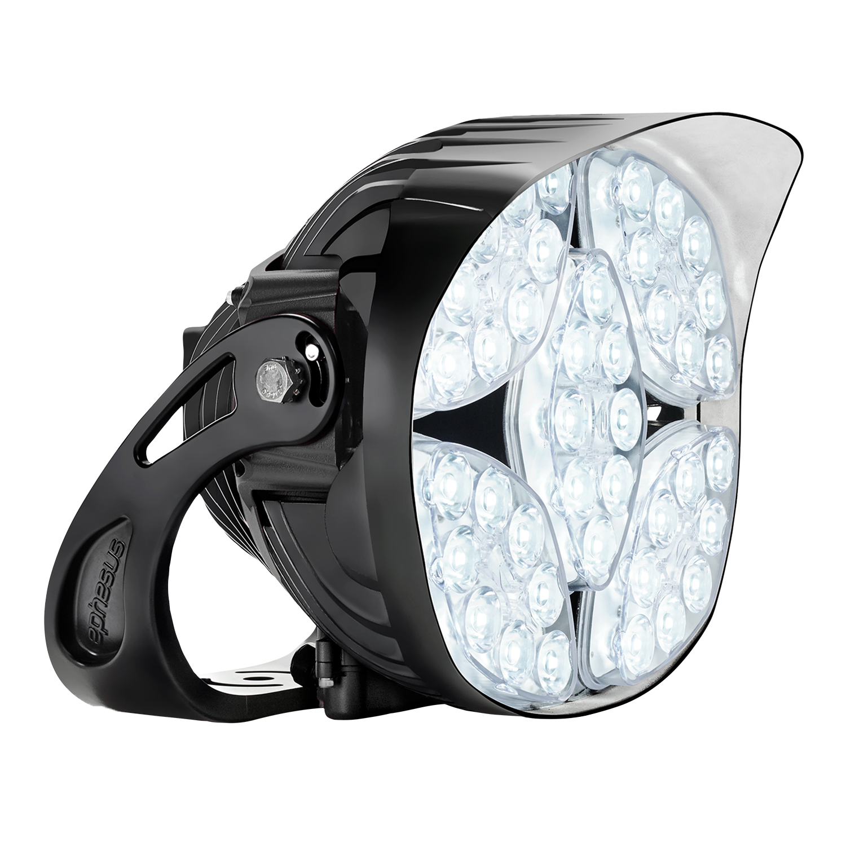
Leisure Services – Sports Complex
LED Field Lights – Cost Breakdown Purchase vs Lease to Own
Option 1 – Purchase outright – $1,587,000
Option 2 – Phased approach
- Football Field - $234,000
- Baseball Stadium - $199,000
- 4 Baseball Fields - $269,000
- 3 Softball Fields - $297,000
- Multi-Purpose Field - $209,000
- Soccer Fields - $379,000
Phase 1 - Football Stadium |  | Down Payment | Monthly
Option 1 | 36 Month Lease | $0.00 | $7,864.00
Option 2 | 60 Month Lease | $0.00 | $5,447.00
Option 3 | 36 Month Lease | $50,000.00 | $6,253.00
Option 4 | 60 Month Lease | $50,000.00 | $4,382.00
Phase 2 - 3 Softball Fields
Option 1 | 36 Month Lease | $0.00 | $8,673.00
Option 2 | 60 Month Lease | $0.00 | $6,001.00
Option 3 | 36 Month Lease | $50,000.00 | $7,062.00
Option 4 | 60 Month Lease | $50,000.00 | $4,936.00
Phase 3 - 4 Baseball Fields
Option 1 | 36 Month Lease | $0.00 | $8,062.00
Option 2 | 60 Month Lease | $0.00 | $5,583.00
Option 3 | 36 Month Lease | $50,000.00 | $6,451.00
Option 4 | 60 Month Lease | $50,000.00 | $4,518.00
Phase 4 - Multi-Purpose Field
Option 1 | 36 Month Lease | $0.00 | $6,264.00
Option 2 | 60 Month Lease | $0.00 | $4,352.00
Option 3 | 36 Month Lease | $50,000.00 | $4,654.00
Option 4 | 60 Month Lease | $50,000.00 | $3,287.00
Phase 5 - 3 Soccer Fields
Option 1 | 36 Month Lease | $0.00 | $11,872.00
Option 2 | 60 Month Lease | $0.00 | $8,192.00
Option 3 | 36 Month Lease | $50,000.00 | $10,262.00
Option 4 | 60 Month Lease | $50,000.00 | $7,127.00
Phase 6 - Baseball Stadium
Option 1 | 36 Month Lease | $0.00 | $6,157.00
Option 2 | 60 Month Lease | $0.00 | $4,278.00
Option 3 | 36 Month Lease | $50,000.00 | $4,546.00
Option 4 | 60 Month Lease | $50,000.00 | $3,213.00

Slide 9
Leisure Services - Accomplishments
Added WIFI to the Sports Complex Football Stadium.
Made necessary adjustments to the city’s special events to provide a safe and healthy alternative. (alter Santa Parade, Great Candy Race, and Mayor’s Fitness Challenge.)
Started a Little League Chapter to bring girls’ softball to the city.
Brought in new programs to the Leisure Services Department (E Sports, youth basketball, pajama party night, youth volleyball, ect.)
Implemented a partnership with ACA to bring musical artists to the Babe James Center.
Offered promo rates for Brannon Center and Live Oak Cultural Center to add rentals, meetings, weddings.
Increased physical activities for youth. Start a fitness challenge for kids in NSB.
Replaced all of site lighting at Sports Complex to LED. Total of 80 lights
Replaced gym lights at Babe James Center and City gym to LED lights.
Brought in 8 load of new clay and had all 8 ballfields at the complex laser graded.
Upgraded the Brannon Centers AV system to include live stream and hybrid meeting access.
Resealed and striped parking lot at Brannon Center and Babe James.

Slide 10
Leisure Services - Goals
Continue to build relationship with CSHD and FABA.
Replace lost revenue and increase Brannon Center revenues by 10%
Review marketing, advertising, and professional organization, and realign for maximum ROI.
Obtain the GBAC Star Facility Accreditation which is considered the gold standard for prepared facilities.
Implement a Crisis Management Plan to cover all aspects and facilities within Leisure Services
Create and implement new recreational activities for the Babe James Center and Sports Complex.
Continue physical upgrades to the buildings and facilities of Leisure Services.
Research and identify ways to make Brannon Center as close to a zero waste facility as possible.
Look into the potential to add LED field lights to the Sports Complex.
Look into adding special events to the Football Stadium.
Add turf to the playground at Babe James
Replace the pump house at the complex.
Add AC to the visitors locker room.

Slide 11
Leisure Services
Questions

