Slide 1

CITY OF
NEW SMYRNA BEACH, fl
1st Public Hearing – millage and budget
September 9, 2020

Slide 2
Tentative City Wide Millage
  General Fund Proposed Operating Millage – 3.7421 (current)
  Debt Service 2005 Millage (expire 2024) - 0.2813 (0.2981 current)
  Debt Service 2018 Millage (expire 2039) - 0.1466 (0.1554 current)
    Total Proposed City Millage of 4.1700
      (current total millage 4.1956 FY2019-2020)
  Roll-back rate would be 3.5530

Slide 3
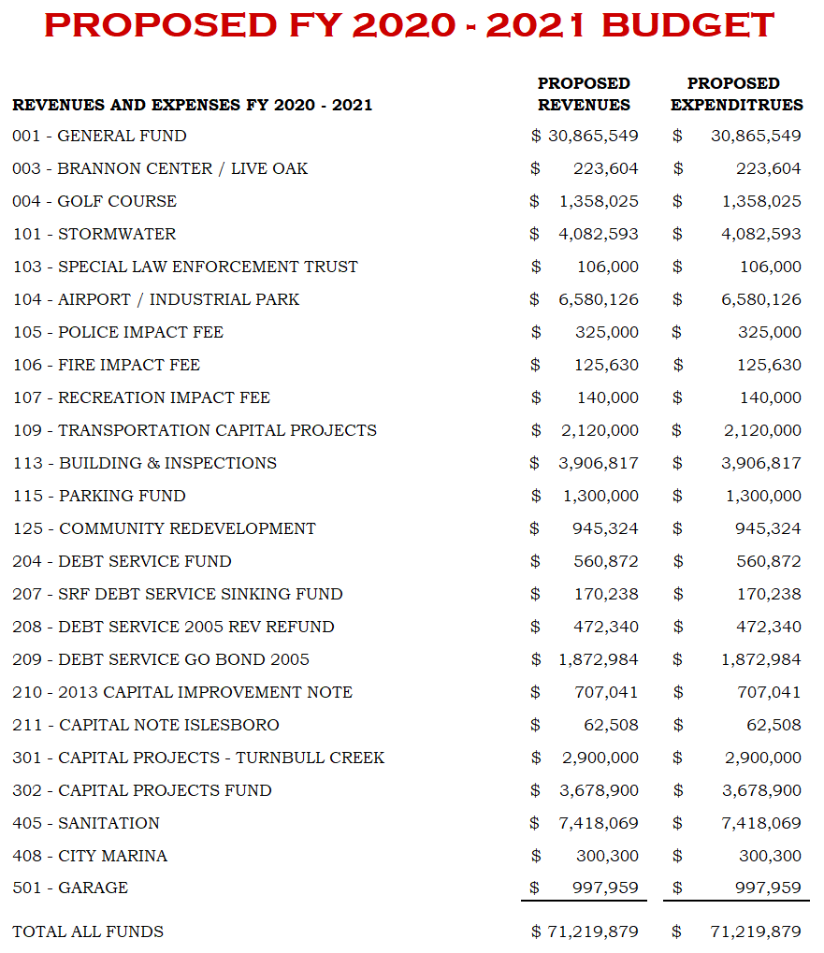
Notes:
Original Proposed : $72,145,392
New Proposed: $71,219,879
Difference: $969,525

Slide 4
Significant Changes
  Fire Impact Fees: Decreased due to the removal of the purchase of a new Fire Truck ($825K)
  Building & Inspections: Increased due to the addition of two (2) new positions ($105K) and the Fiber Optic Capital Project with the UC ($250K)
  Parking Fund: Increased due to the addition of two (2) new positions ($50K)
  Parking Fund: Increased due to the Parking Fund initiative with the County ($250K)
  General Fund: Re-appropriated funds ($100K) to cover expected loan costs
  Storm water: Increased to cover the expected loan costs ($50k), and the transfer of ($35K) for a new truck.

Slide 5
Unfunded Capital Improvement Projects
Project | Est. Total Project Cost | Est. City Cost
5th Street Bridge | 4,529,104 | 2,496,491
Barracuda Bridge | 3,210,094 | 728,774
HMPG Flood Mitigation | 6,241,942 | 787,921
US 1 Median Landscaping | 681,200 | 200,000
SR44 Median Landscaping | 439,100 | 150,000
Washington Street | 3,400,000 | 1,360,000
Total | $18,501,440 | $5,723,186

Slide 6
2021 Taxable Value By Property Class
Source: Volusia County Property Appraiser

Slide 7
What percentage of an average Property Tax bill goes to the City?
This graphic display shows what a homeowner would pay in ad valorem taxes on a homesteaded property in the City of New Smyrna Beach with an assessed value of $189,219.
FY 2020 - $3,561.03 Total Tax bill
New Smyrna Beach Portion - $793.89

Slide 8
Comparison of current Millage rate
Notes:
This slide shows comparison of current millage rate across the County of Volusia. NSB is the second from the last.

Slide 9
Next Step
  2nd Public hearing on the FY21 Budget
    September 22nd, 2020

