Slide 1

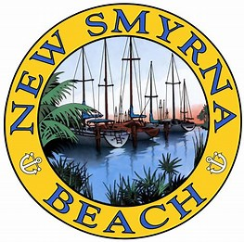
Primary Contacts:
Mark Galvin, Regional Managing Director | mark.galvin@hilltopsecurities.com
Matthew Sansbury, Managing Director | matthew.sansbury@hilltopsecurities.com
450 S. Orange Avenue, Suite 460
Orlando, Florida 32801
(407) 426-9611
Updated Proposed 2021 Financing Plan for Unfunded Projects
September 9, 2020
CITY OF NEW SMYRNA BEACH, FLORIDA

Slide 2

Table of Contents
1. Project Overview
2. Goals and Objectives
3. Financing Options
4. Next Steps
Member FINRA / SIPC / NYSE
© 2020 Hilltop Securities Inc.
All Rights Reserved

Slide 3
Project Overview
Total Project Costs: $18,501,440
Total Cost of FEMA and Property Owners Reimbursement Projects: $6,241,942
  HMGP Flood Mitigation Projects
Total Cost of FDOT / State Grant Reimbursement Projects: $12,259,498
  5th Street Bridge Replacement
  Barracuda Bridge Replacement
  Washington Street Improvements
  US 1 Median Landscaping Improvements
  SR 44 Median Landscaping Improvements
Member FINRA / SIPC / NYSE
© 2020 Hilltop Securities Inc.
All Rights Reserved

Slide 4
Project Overview
Project Costs that will be Reimbursed by FEMA, Property Owners, FDOT / State Grants and Transportation Impact Fee: $11,943,555
  Flood Mitigation Projects (FEMA $4,389,486; Property Owners $1,064,535)
  5th Street Bridge (FDOT $1,271,664)
  Barracuda Bridge (FDOT $2,407,570)
  Washington Street (FDOT / State Grant $1,020,000*; Transportation Impact Fees $1,020,000)
  US 1 Median (FDOT $481,200)
  SR 44 Median (FDOT $289,100)
City’s Portion of the Projects: $6,557,885
  Previously Encumbered Funds ($834,699)
  Loan Proceeds ($5,723,186)
*Assumes the approval and receipt of FDOT Reimbursement or State Grant for Washington Street Improvements of $1,020,000.
Member FINRA / SIPC / NYSE
© 2020 Hilltop Securities Inc.
All Rights Reserved

Slide 5
Goals and Objectives
  Secure funding for approximately $18.5 million of projects using a combination short-term / long-term and tax-exempt / taxable financing mechanisms
  Provide financial flexibility to the City for current and anticipated future projects
  For the short-term portion of the financing ($11,943,555), use a drawdown variable rate bank line of credit to reduce interest expense and to allow for ease of prepayment
  For the long-term portion of the financing ($5,723,186), lock-in a tax-exempt fixed rate loan that provides for the ability to prepay prior to maturity
Member FINRA / SIPC / NYSE
© 2020 Hilltop Securities Inc.
All Rights Reserved

Slide 6
Financing Options
Financing would consist of two series:
  Short-term financing for the portion of the projects that will be reimbursed ($11,943,555)
    5-year floating rate line of credit (estimated interest rate of 3%)
    Can be prepaid at any time
    Portion of Flood Mitigation projects to be reimbursed by property owners would need to be taxable; remainder could be tax-exempt
  Medium to long-term financing for the City’s portion of the projects ($5,723,186)
    Tax-exempt fixed rate bank loan
    Final maturity up to 20 years (depending on the City’s preference)
    Seek favorable prepayment provisions
Member FINRA / SIPC / NYSE
© 2020 Hilltop Securities Inc.
All Rights Reserved

Slide 7
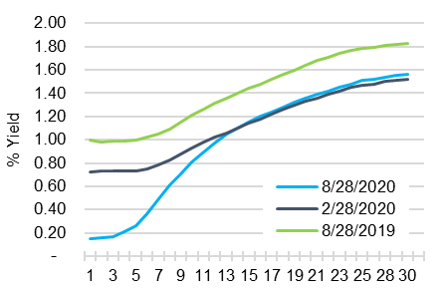
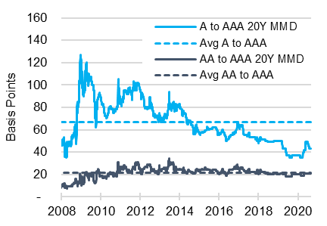
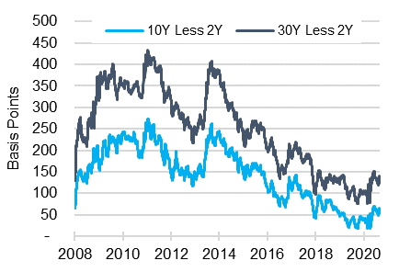
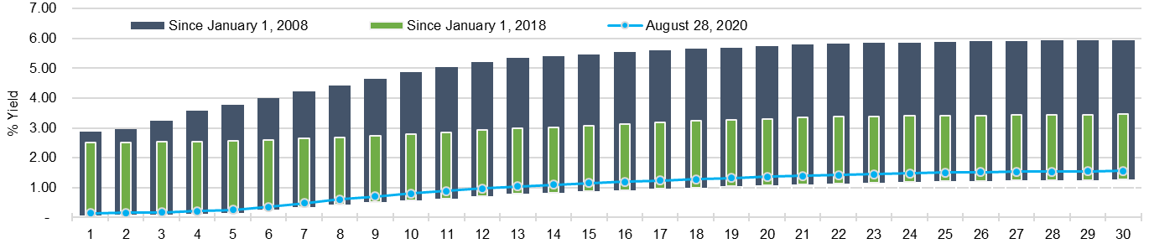
Financing Options
Interest rates are extremely low historically and the tax-exempt yield curve is relatively flat
AAA MMD Yield Curve Comparison
MMD Credit Spreads to AAA – 1/1/08 to 8/28/20
AAA Yield Curve Steepness – 1/1/08 to 8/28/20
Maximum and Minimum AAA MMD Yields
Source: Refinitiv Municipal Market Data
Member FINRA / SIPC / NYSE
© 2020 Hilltop Securities Inc.
All Rights Reserved

Slide 8
Financing Options
Comparison of a 15-year and 20-year bank loan
*Debt Service numbers include an additional 10% Project Contingency.
Member FINRA / SIPC / NYSE
© 2020 Hilltop Securities Inc.
All Rights Reserved

Slide 9
Financing Options
Additional Financing Considerations
  Washington Street Improvements
    City is still awaiting approval by FDOT / State Grants for Washington Street Improvements ($1,020,000)
  Other Unfunded Capital Improvements
    City may want to consider funding other Unfunded Capital Improvement Projects
Long-Term Notes Sensitivity Analysis
  For every $1 million in additional project funds, the estimated annual debt service on the long-term financing would increase by:
    $71,500 for the 15-year option
    $60,000 for the 20-year option
Member FINRA / SIPC / NYSE
© 2020 Hilltop Securities Inc.
All Rights Reserved

Slide 10
Next Steps
Finalize the projects to be financed
Develop timetable for funding short-term and long-term loans
Issue RFPs for bank for line of credit / long-term bank loan
Line of credit and bank loan financings will take 60 to 90 days to complete from start-to-finish
Any questions?
Member FINRA / SIPC / NYSE
© 2020 Hilltop Securities Inc.
All Rights Reserved

Slide 11
General Disclosure
This communication is intended for issuers for educational and informational purposes only and does not constitute legal or investment advice, nor is it an offer or a solicitation of an offer to buy or sell any investment or other specific product or service. Financial transactions may be dependent upon many factors such as, but not limited to, interest rate trends, tax rates, supply, change in laws, rules and regulations, as well as changes in credit quality and rating agency considerations. The effect of such changes in such assumptions may be material and could affect the projected results. Any outcome or result Hilltop Securities Inc. (“HilltopSecurities”), or any of its employees, may have achieved on behalf of our clients in previous matters does not necessarily indicate similar results can be obtained in the future for current or potential clients. HilltopSecurities makes no claim the use of this communication will assure a successful outcome. This communication is intended for institutional use only. For additional information, comments or questions, please contact HilltopSecurities.
Member FINRA / SIPC / NYSE
© 2020 Hilltop Securities Inc.
All Rights Reserved

